Slide 1

MIA Pipeline – Registration
Luca Sahli, Jacob Rasmussen and Camilo Mendez MIA-Lab
Fall 2017

Slide 2
Overview
Introduction
Affine Transformation
Method
Optimization
Result 1
Bspline Transformation
Method
Result 2

Slide 3
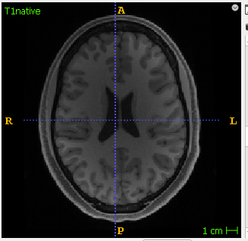
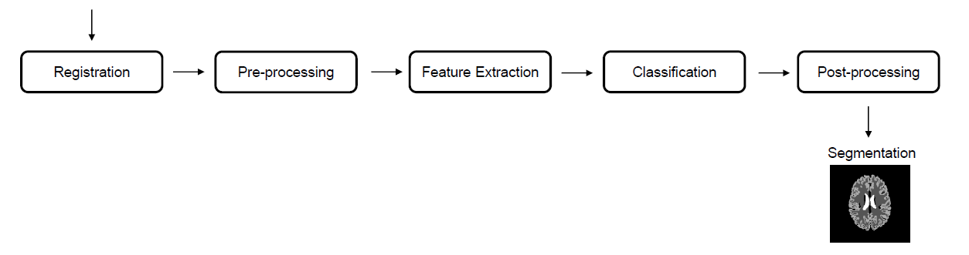
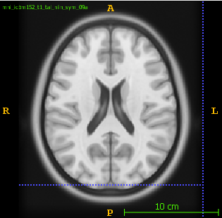
Introduction
T1w
AtlasT1

Slide 4
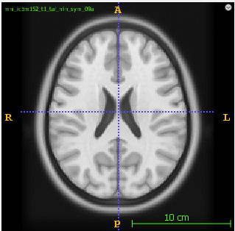
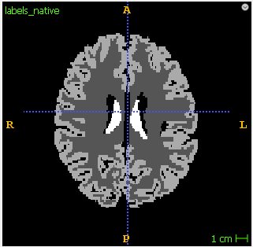
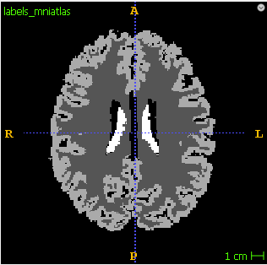
Introduction - sequence
Affine
Registration
TAffine
T1_native
T1_atlas
TAffine
labels_registerd
labels_native
labels_registerd

Slide 5
Introduction - evaluation
Evaluator
Dice coefficients
labels_registerd
labels_mniatlas/
ground truth

Slide 6

Methods - Affine
We use AffineRegistration() from the Simpleitk library
def __init__(self, number_of_histogram_bins: int=200,
learning_rate: float=1.0, step_size: float=0.001, number_of_iterations: int=200, relaxation_factor: float=0.5,
shrink_factors: [int]=(2, 1, 1), smoothing_sigmas: [float]=(2, 1, 0),
sampling_percentage: float=0.2):

Slide 7
Methods - optimization
Pseudocode for optimization
For each Setting of parameters
For 10 patients
Dice[White, Grey, Ventricles] = evaluate()
Save mean Dice over the 10 patients
Choose setting with highest Dice

Slide 8
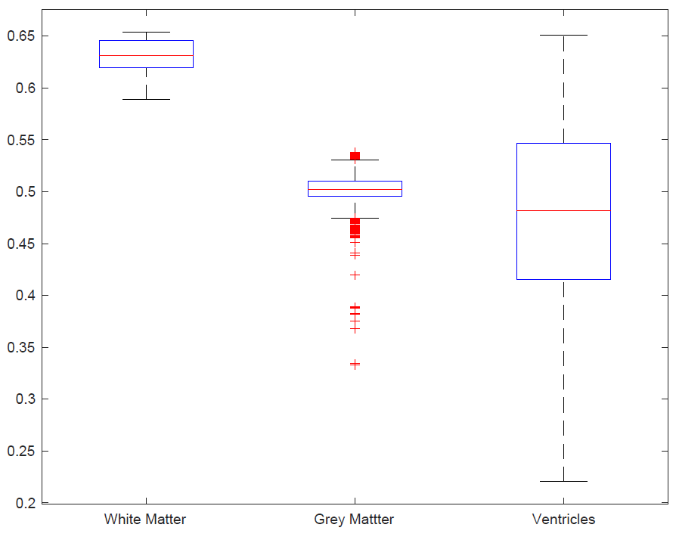
Result 1 - Affine
Best Parameters:
.
.
.

Slide 9
Bspline
Bspline

Slide 10
Methods - Bspline
We use BSplineRegistration() from the Simpleitk library
def __init__(self,
number_of_bins: int = 50,
number_of_iterations: int = 1500,
gradient_Convergence_Tolerance: float = 1e-5,
max_number_of_corrections: int = 100,
max_number_of_function_evaluations: int = 1000,
cost_function_convergence_factor: float = 1e+7,
sampling_percentage: float = 0.2,
transformDomainMeshSize = [10,10,10]):

Slide 11
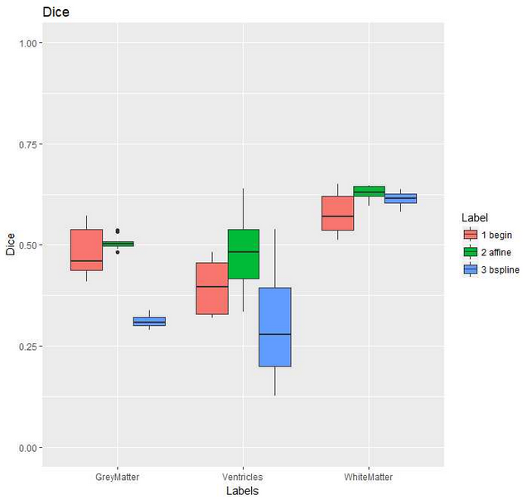
Result 2 – Affine/ Bspline

Slide 12
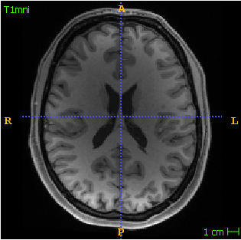
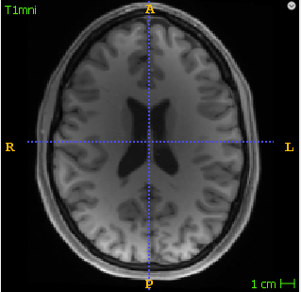
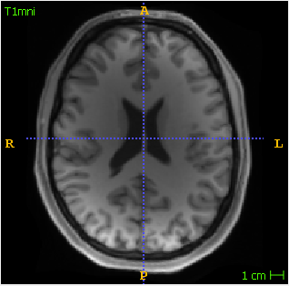
Result 2 – Affine/ Bspline
Begin
Affine
BSpline
Dice:
White matter 0.51
Grey matter 0.42
Ventricles 0.33
Mean 0.42
Dice:
White matter 0.62
Grey matter 0.48
Ventricles 0.64
Mean 0.58
Dice:
White matter 0.64
Grey matter 0.31
Ventricles 0.51
Mean 0.49

Slide 13
Conclusions
…

Slide 14
Outlook
SimpleElastix

Slide 15
Methods
histList = [10, 50, 100, 200, 300]
learnRateList = [0.1, 0.2, 0.9]
iterList = [100, 200, 1000]
Patient 1
Patient 2
Patient 3
…
Patient 10
..
..
..
..
..
..
..
..
..
..
..
..
..
..
..
mean
..
..
..

